Slide 1
Unit 1. Computing Environments
1.1 Introduction to Computer Science
Definition of Computer Science
Areas of Study

Slide 2
What is Computer Science?
“Science” is:
The effort to discover and increase understanding of how something works through controlled methods (experimentation), observation, and analysis.

Slide 3
Computer Science
Definition:
The scientific study of computation and computer technology, hardware and software
The study of the theoretical foundations of information and computation, and their implementation and application in computer systems
Combination of mathematics and engineering disciplines (even some philosophy!)
Computer science is fundamentally about computational problem solving

Slide 4
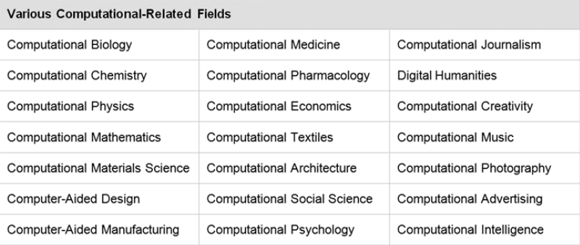
Areas of Study
There are various areas of study in computer science including software engineering (the design and implementation of large software systems), database management, computer networks, computer graphics, computer simulation, data mining, information security, programming language design, systems programming, computer architecture, human–computer interaction, robotics, and artificial intelligence, among others.

Slide 5

Practice Questions
1. A good definition of computer science is “the science of programming computers.”
(TRUE/FALSE)
2. Which of the following areas of study are included within the field of computer science?
(a) Software engineering
(b) Database management
(c) Information security
(d) All of the above
3. Search online for two areas of computer science other than those given on the previous page.

Slide 6

Do you agree?
“Computer science is no more about computers than astronomy is about telescopes.”
Edsger Dijkstra
Portrait of Edsger W. Dijkstra Photograph by Hamilton Richards Licensed under the Creative Commons Attribution-Share Alike 3.0 Unported license
http://creativecommons.org/licenses/by-sa/3.0/deed.en

